Slide 1

Video Action Recognition
Frame-Based Deep Learning Models

Slide 2
Project Overview
This project explores video action recognition using pre-extracted image frames, eliminating the need for direct video processing. We'll use sequential visual data to capture both appearance and motion cues.
Spatial Features
Temporal Dependencies
Performance Comparison
Leveraging CNNs for individual frame analysis.
Using RNNs (LSTM, GRU) to model frame sequences.
Evaluating multiple architectures for optimal spatio-temporal learning.

Slide 3






Learning Objectives
CNNs for Spatial Features
Spatio-Temporal Learning
Interpret CNNs' role in extracting frame features.
Understand frame-based video action recognition.
RNNs for Temporal Data
Apply RNN variants (LSTM, GRU) for sequence modeling.
Evaluate & Justify
Compare models and select the best architecture.
Design & Implement Models
Develop CNN-only, RNN-based, and CNN-RNN hybrid architectures.

Slide 4
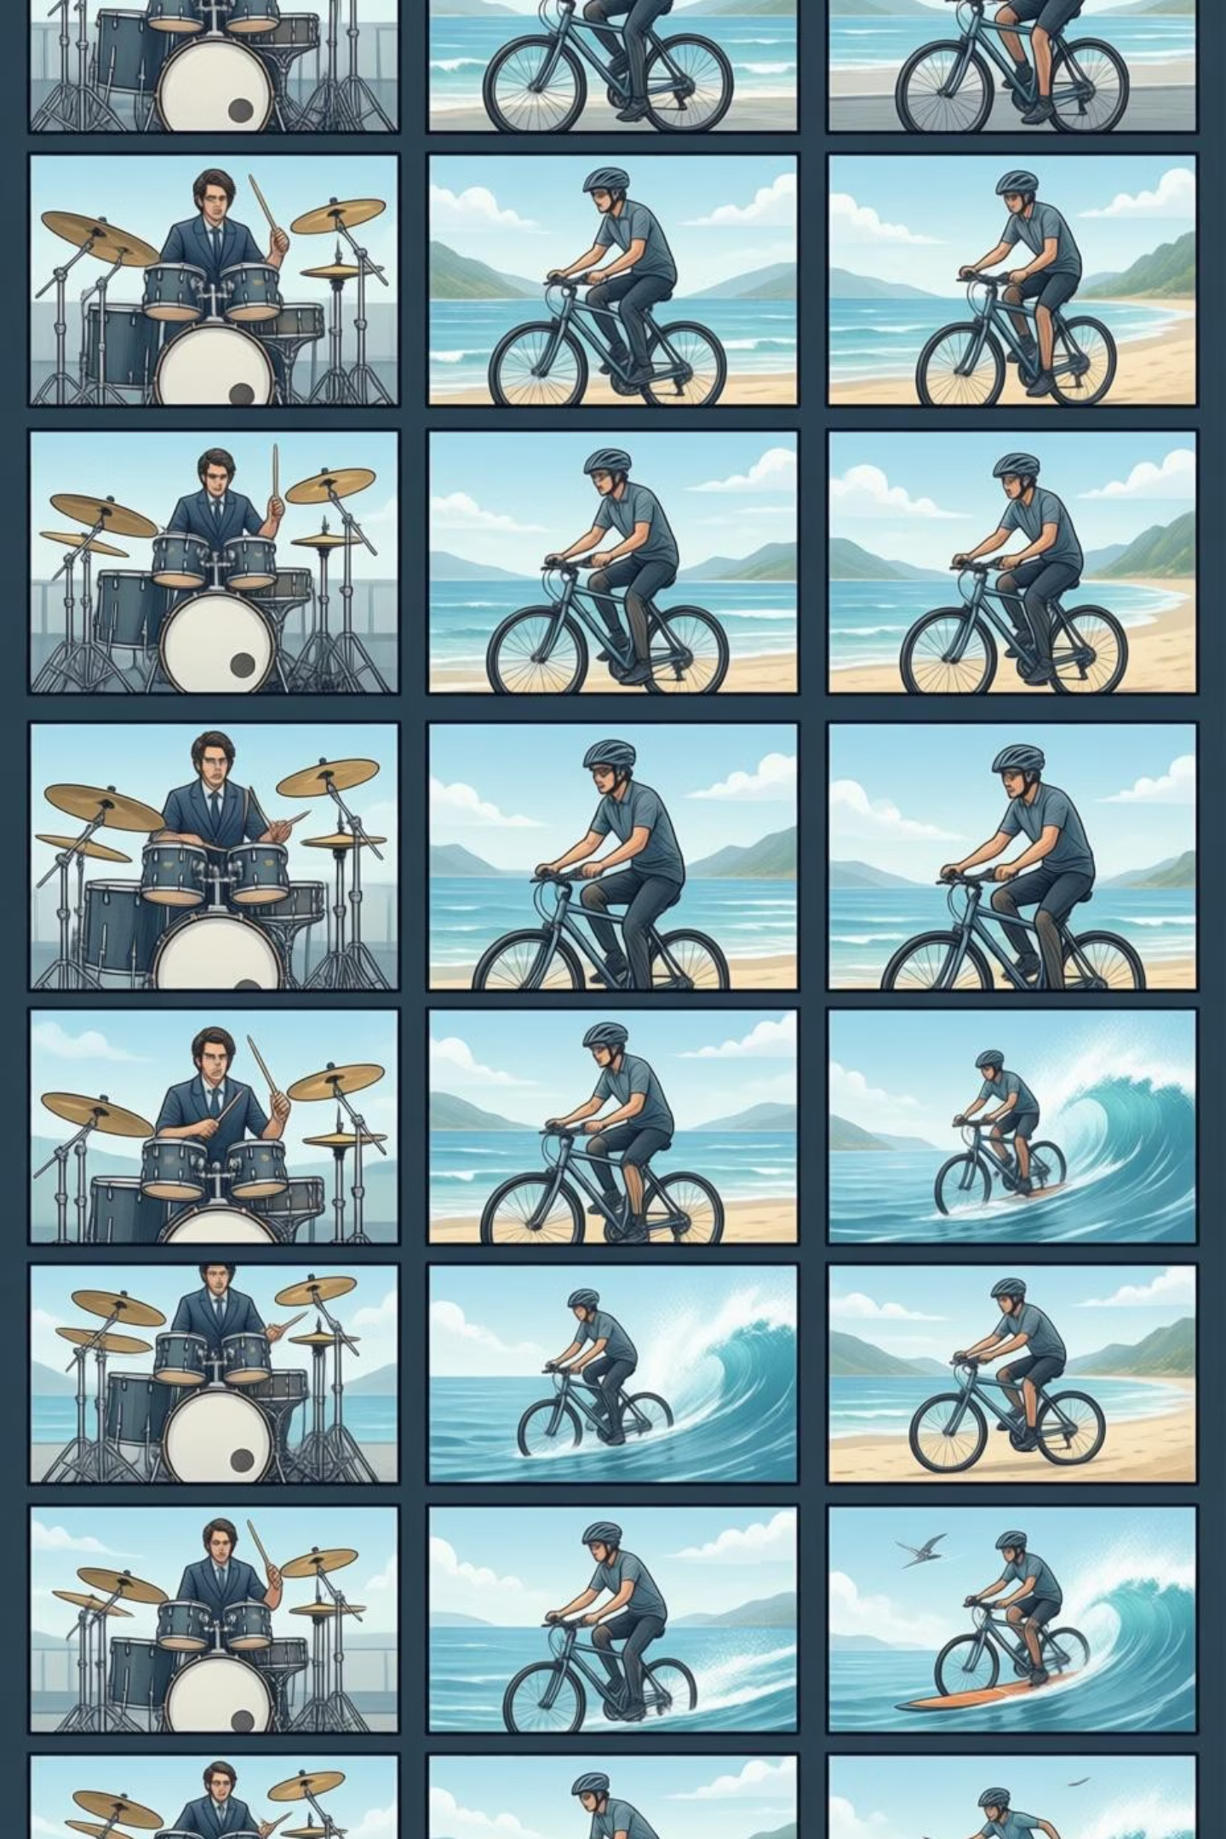
Dataset: UCF101 Frames
Download the dataset: UCF101 Frames Dataset
Select 10 action categories.
Use up to 100 videos per category for training and evaluation.
Total: 1,000 videos (10 categories × 100 videos).

Slide 5

Project Tasks: Data Preparation
1. Dataset Selection & Sampling
1
Choose 10 action categories and sample 100 videos/category for a balanced dataset.
2. Data Understanding & Preprocessing
2
Analyze frame sequences, resize/normalize frames, ensure consistent length, encode labels.

Slide 6
Project Tasks: Model Implementation
3. Baseline Model (CNN)
4. Sequence Modeling (RNN Variants)
5. CNN–RNN Hybrid Development
Implement a CNN for frame-level classification. Train on individual frames, evaluate performance.
Extract CNN features, then use RNN, LSTM, GRU to model temporal dependencies.
Integrate CNN for spatial and RNN (LSTM/GRU) for temporal modeling. Compare with other models.

Slide 7
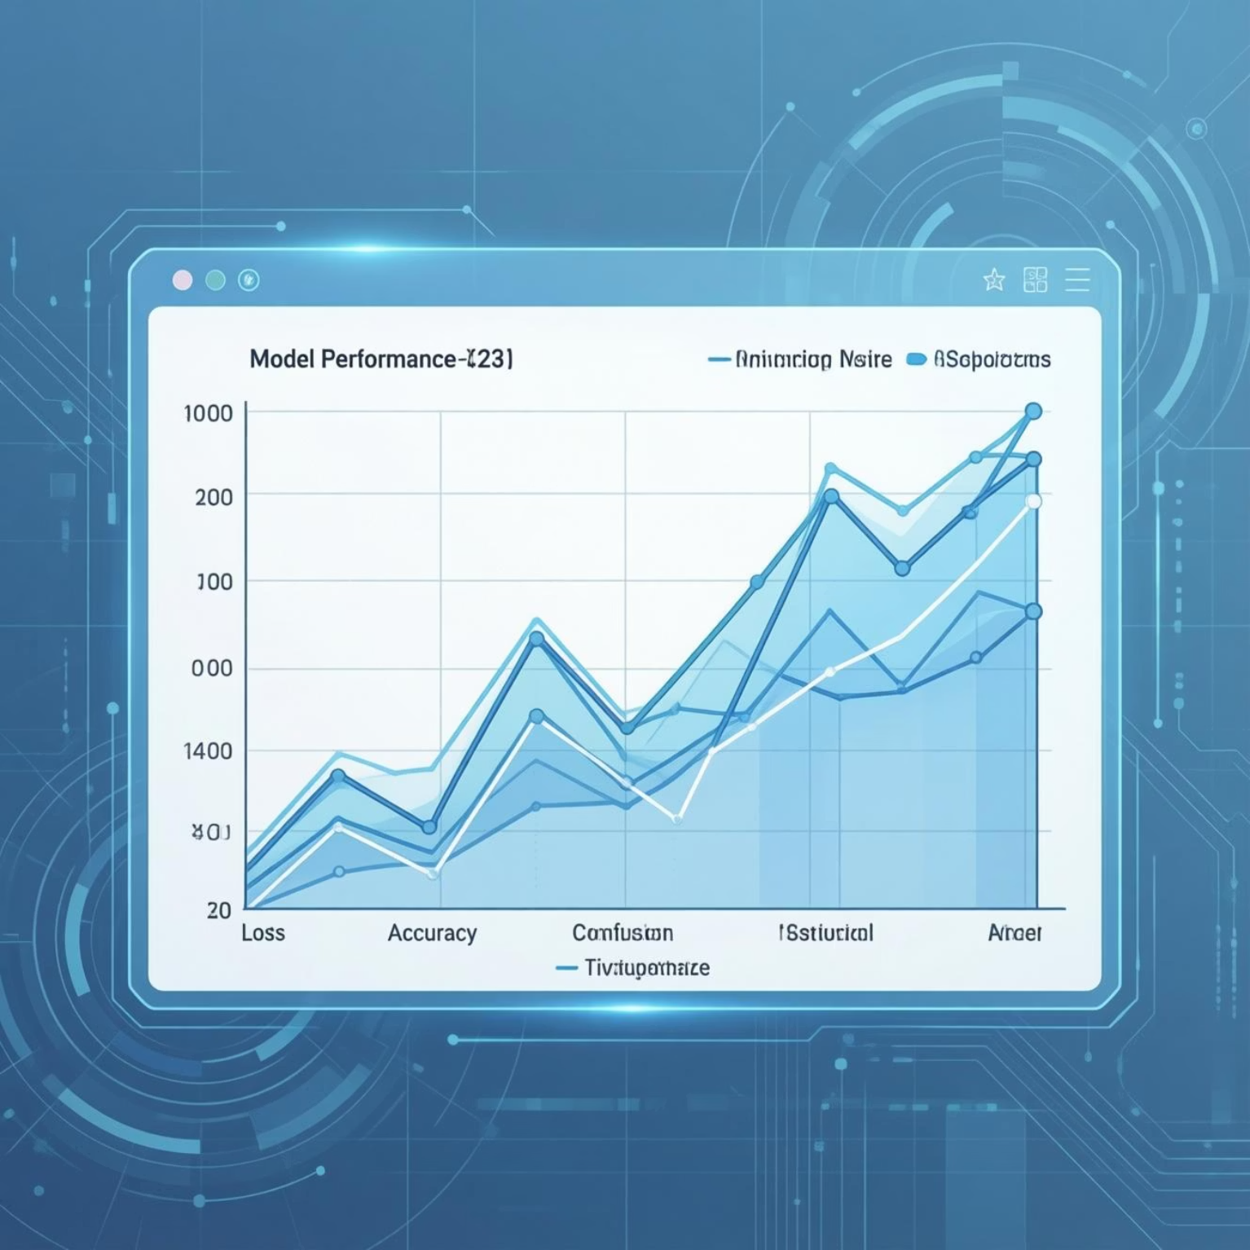
Project Tasks: Evaluation & Analysis
6. Model Evaluation & Comparison
1
Assess all models using accuracy, loss, and confusion matrix. Plot performance curves. Select and justify the best model.
7. Results Visualization & Analysis
2
Visualize predictions, analyze misclassifications, and summarize insights from model comparisons.

Slide 8

Project Tasks: Conclusion
8. Conclusion & Future Scope
Summarize findings, discuss challenges, and suggest potential improvements for frame-based modeling.
This project aims to provide practical insights into deep learning-based video understanding and frame-level video analytics.

